Slide 1
Syllabus of Embedded System
Unit 2: Programming for Embedded Systems (5 Hours)
2.1 Overview of AVR Architecture
2.2 Embedded C Programming for Microcontroller
  Introduction to C for Embedded Systems
  Data Types, Control Structures, and pointers
  Memory Management
  AVR Interrupt handling
  Input and output ports interfacing on AVR
  Timers and Counters in AVR
  Serial Communication in AVR

Slide 2
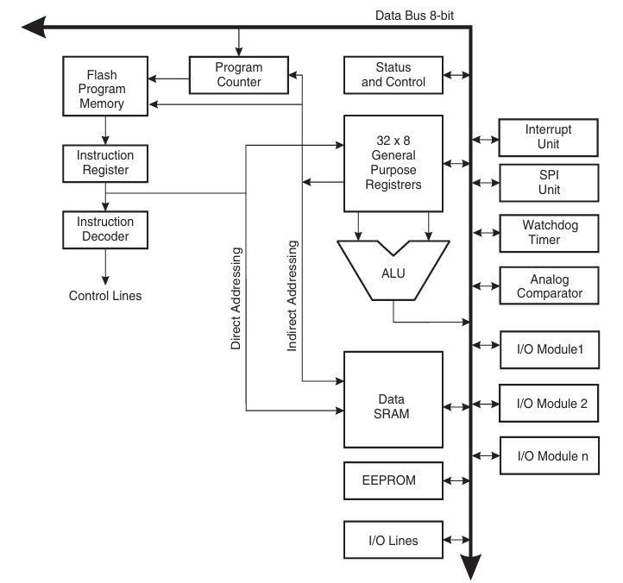
Overview of AVR Architecture
AVR is a family of 8-bit RISC microcontrollers developed by Atmel (now Microchip).
It was one of the first microcontroller families to use on-chip Flash memory for program storage.
The name AVR stands for Alf-Egil Bogen and Vegard Wollan's RISC processor.
It is based on a Harvard architecture, which separates program and data memory.

Slide 3
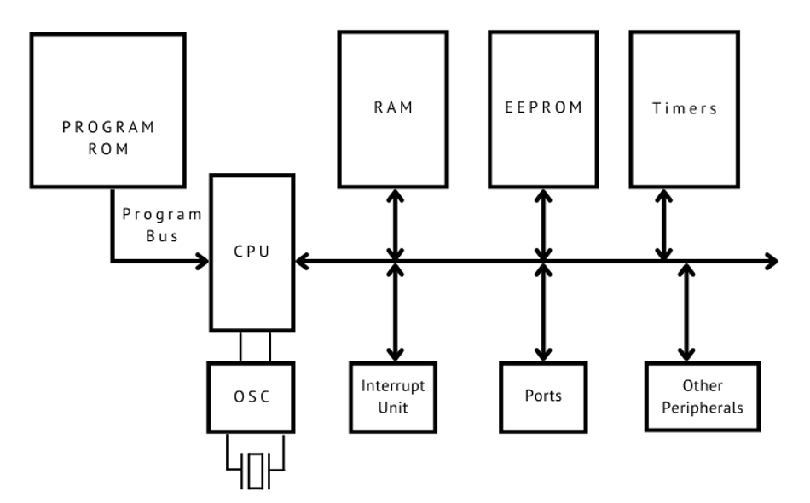
Overview of AVR Architecture

Slide 4
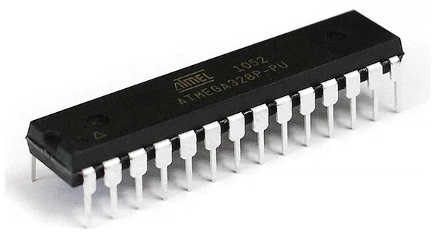
Overview of AVR Architecture
RISC Architecture: (Reduced Instruction Set Computer). Features a rich instruction set where most instructions execute in a single clock cycle.
High Performance: Achieves high throughput (approaching 1 MIPS per MHz) by executing instructions quickly and efficiently.
Modified Harvard Architecture: Uses separate buses and memories for Program (Flash) and Data (SRAM), allowing simultaneous access and improving speed.
32 General-Purpose Registers: A large register file, with all registers directly connected to the ALU (Arithmetic Logic Unit).

Slide 5





Overview of AVR Architecture
Memory Architecture
32KB Flash (Program)
2KB SRAM (Data)
1KB EEPROM (Data)
In-System Programmable (ISP) non-volatile memory used for storing the program code. It can be reprogrammed thousands of times.
Static RAM. This is volatile memory used for storing variables, stack, and data during runtime. All data is lost when power is off.
Non-volatile memory used for storing data that must be saved when power is off, such as configuration settings or calibration data.

Slide 6
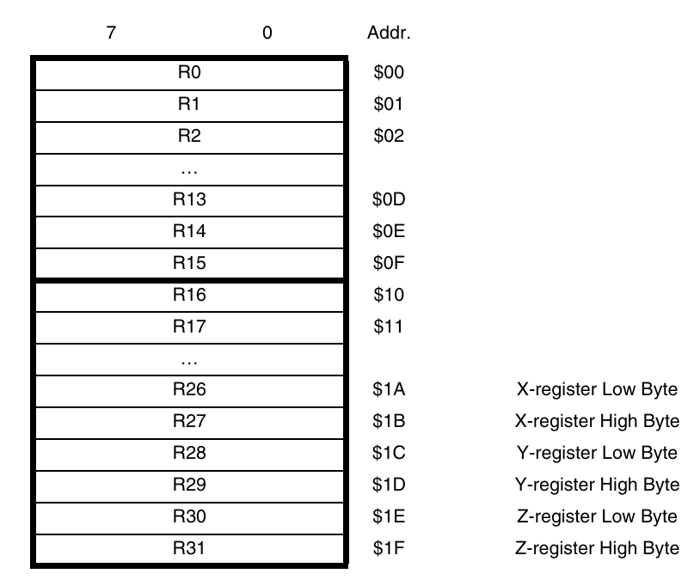
Overview of AVR Architecture
Memory Architecture
fig: 32x8 register

Slide 7
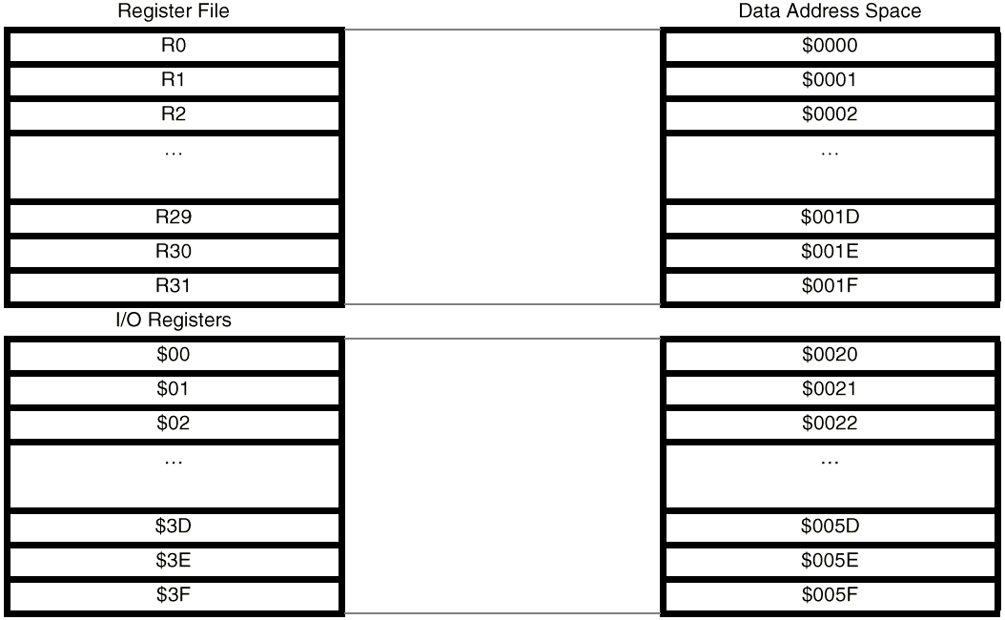
Overview of AVR Architecture
Memory Architecture

Slide 8
Overview of AVR Architecture
Memory Architecture

Slide 9


Overview of AVR Architecture
CPU and Register File
Arithmetic Logic Unit (ALU)
General Purpose Registers
The high-performance ALU is directly connected to all 32 general-purpose registers. This allows it to access two independent registers, perform an operation, and write the result back in a single clock cycle.
The 32 x 8-bit registers (R0-R31) are the heart of the AVR core. This fast-access register file is the heart of the CPU's operation, reducing the need to access the slower data SRAM.

Slide 10
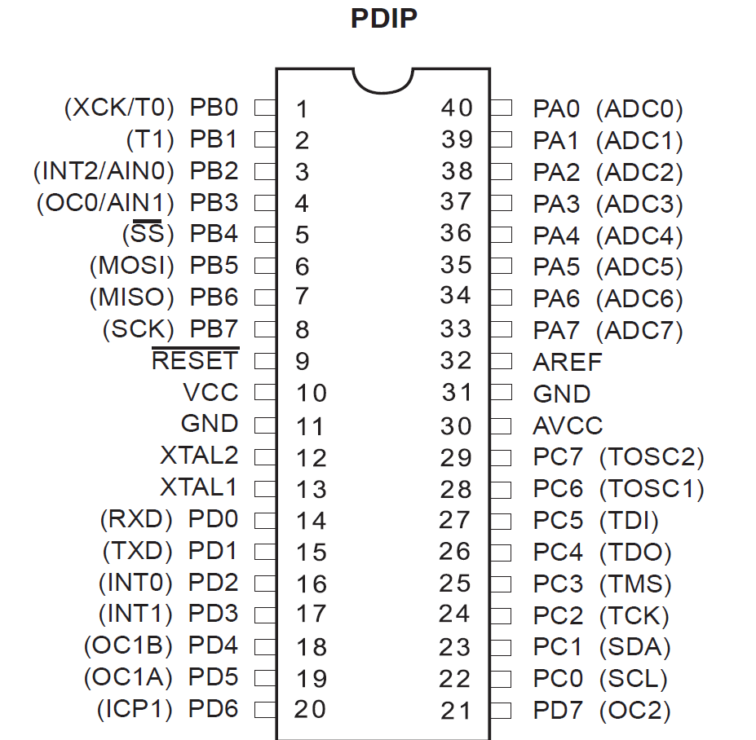
Overview of AVR Architecture
I/O ports
The ATmega32 features four 8-bit I/O ports: PORTA, PORTB, PORTC, and PORTD (totaling 32 I/O lines).
Each pin is bi-directional and can be configured as either an input or an output using three key registers:
DDRx: Data Direction Register (sets pin as input/output).
PORTx: Data Register (writes output data or enables pull-up).
PINx: Input Pins Address (reads the logic level from the pin).

Slide 11

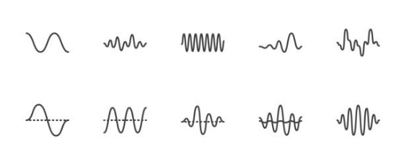
Overview of AVR Architecture
Timers and ADC
Timers/Counters: Features three timers (two 8-bit, one 16-bit). Used for timing events, generating PWM (Pulse Width Modulation), and counting external events.
Analog-to-Digital Converter (ADC): A 10-bit, 8-channel ADC. This converts real-world analog signals (like from sensors) into digital values the MCU can understand.

Slide 12





Overview of AVR Architecture
Communication System
USART
SPI
TWI (I²C)
(Universal Synchronous/Asynchronous Receiver/Transmitter) For serial communication with PCs or other devices (e.g., RS-232).
(Serial Peripheral Interface) A fast, synchronous, full-duplex communication protocol often used for high-speed peripherals like SD cards.
(Two-Wire Interface) A multi-master, multi-slave serial bus (identical to I²C) commonly used for connecting sensors and peripherals.

Slide 13
Overview of AVR Architecture
Interrupt System
Interrupts allow the MCU to respond to critical events (like a button press or data arrival) without halting the main program.
The ATmega32 has a powerful interrupt structure with multiple sources, including:
•
External Interrupts (INT0, INT1, INT2)
•
Timer Overflows/Compares
•
ADC Conversion Complete
•
USART, SPI, and TWI events

Slide 14
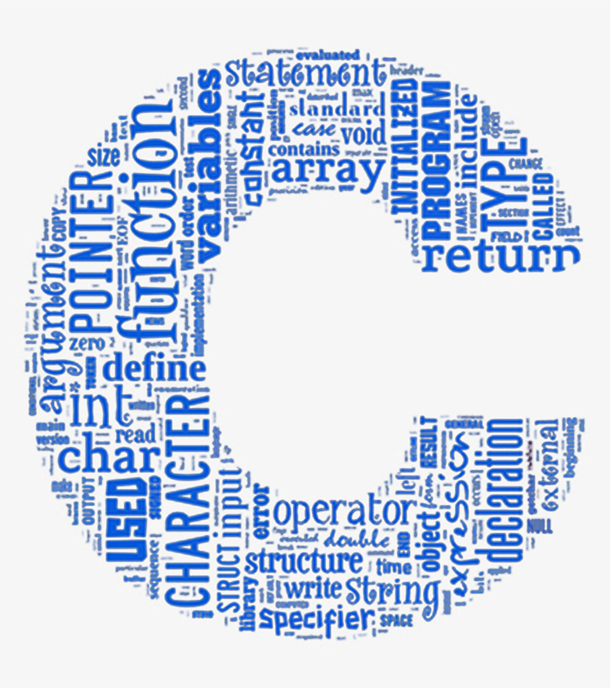
Introduction to C for embedded system
Why C for embedded systems?
Close to hardware but still high-level
Efficient and generates small, fast machine code
Full control over memory
Direct access to registers

Slide 15
Introduction to C for embedded system
No printf(), no screen, no keyboard
Everything is done through:
Registers
Peripherals
External interfaces (LEDs, sensors, serial)
No dynamic memory (avoid malloc, free)
Bad for small RAM microcontrollers.
main() never ends
There is no operating system to return to.
Timing is critical
Delays, timers, interrupts are essential.

Slide 16
Data types, Control structures and Pointers
C Type | Size on ATmega32 | Range | Notes
char | 1 byte (8-bit) | –128 to 127 | Most operations are 8-bit, very fast
unsigned char / uint8_t | 1 byte | 0 to 255 | Most common for registers
int / signed int | 2 bytes (16-bit) | –32768 to 32767 | Default integer type
unsigned int | 2 bytes | 0 to 65535 | Good for timer values
long | 4 bytes |  | Slower—avoid unless needed
float | 4 bytes |  | VERY slow on AVR, avoid in ISR & tight loops
Preferred types are uint8_t, uint16_t, uint32_t

Slide 17
Data types, Control structures and Pointers
If-else
& is ANDing and << is SHIFTing.
if (PINB & (1 << PB0)) {
PORTC |= (1 << PC0);
} else {
PORTC &= ~(1 << PC0);
}
| is ORing

Slide 18
Data types, Control structures and Pointers
switch-case
switch(mode) {
case 0: run_motor(); break;
case 1: stop_motor(); break;
case 2: reverse_motor(); break;
}
Used in
Finite state machine
Menu systems

Slide 19
Data types, Control structures and Pointers
while(1)
while (1) {
read_sensor();
update_output();
}
while(1) is the backbone of main()

Slide 20
Data types, Control structures and Pointers
for loops
for (uint8_t i = 0; i < 8; i++) {
PORTA = (1 << i);
_delay_ms(200);
}
Used for
Short delays
Repetitive GPIO patterns

Slide 21
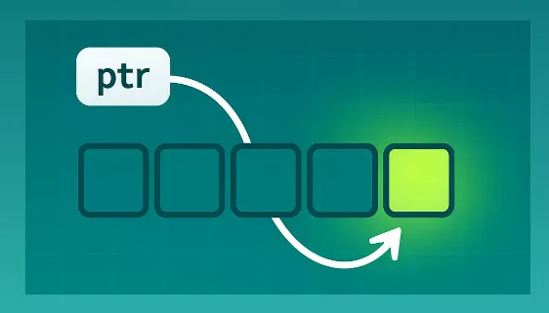
Data types, Control structures and Pointers
pointers
A pointer in C is a variable that stores the address of another variable.

Slide 22
Data types, Control structures and Pointers
pointers
Use of pointers
Access hardware registers directly
Manipulate port registers dynamically
Pass variables to functions by reference
uint8_t x = 10;
uint8_t *ptr = &x;

Slide 23
Data types, Control structures and Pointers
Registers are memory addresses that control hardware.
DDRC |= (1 << PC0); // Set PC0 as output
PORTC &= ~(1 << PC0); // Set PC0 LOW
avr/io.h defines all register name like PORTA, DDRA, PINA, etc
|= , &=~ are used to set/clear bits.

Slide 24
Data types, Control structures and Pointers
volatile
Use volatile when:
Variable is a hardware register
Variable is modified by an interrupt
Variable is changed by hardware (ADC, Timer, UART)
Variable is shared between main code and ISR
Variable might change without your program writing to it
volatile uint8_t *portA = (uint8_t*)0x1B;
*portA = 0xFF; // Write to PORTA

Slide 25
Data types, Control structures and Pointers
#include <avr/io.h>
int main(void) {
DDRA = 0xFF; // Configure PORTA as output
PORTA = 0b10101010; // Output pattern
while (1) {
// Endless loop
}
}
#include <avr/io.h> : Gives access to all Atmega registers
main(): program starts here
while(1): program starts here

Slide 26
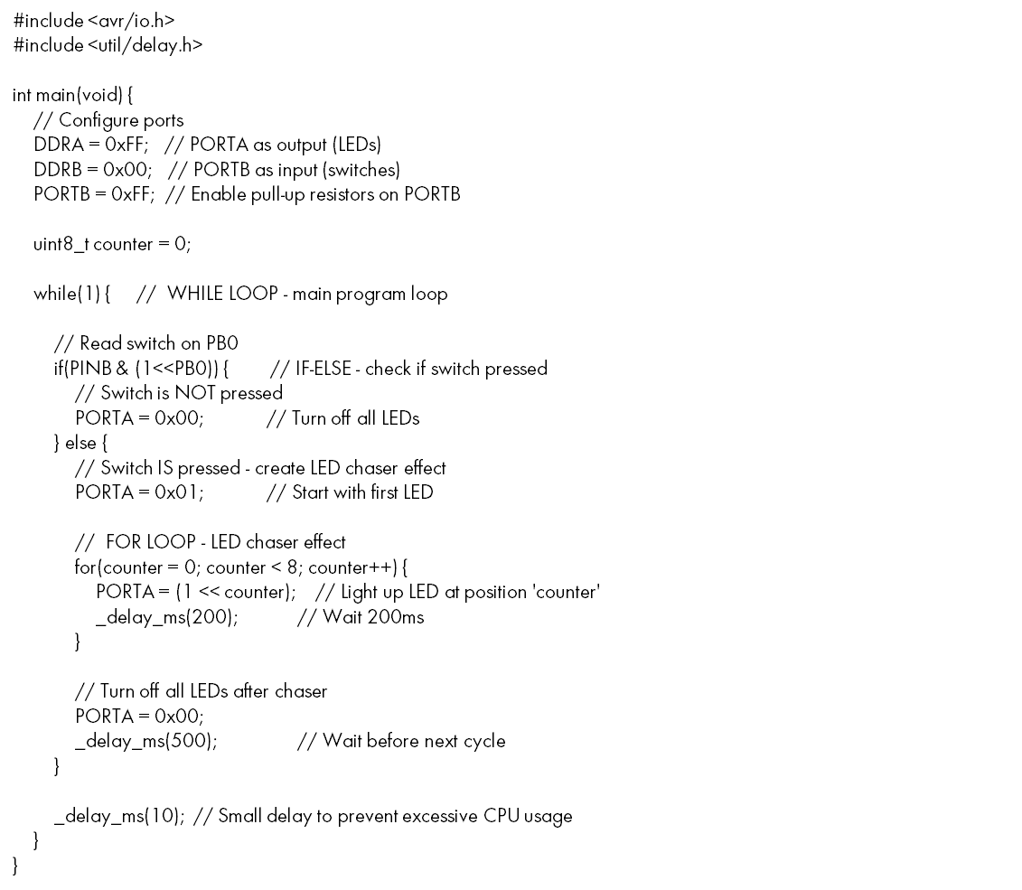
Data types, Control structures and Pointers
#include <avr/io.h>
#include <util/delay.h>
int main(void) {
// Configure ports
DDRA = 0xFF; // PORTA as output (LEDs)
DDRB = 0x00; // PORTB as input (switches)
PORTB = 0xFF; // Enable pull-up resistors on PORTB
uint8_t counter = 0;
while(1) { // WHILE LOOP - main program loop
// Read switch on PB0
if(PINB & (1<<PB0)) { // IF-ELSE - check if switch pressed
// Switch is NOT pressed
PORTA = 0x00; // Turn off all LEDs
} else {
// Switch IS pressed - create LED chaser effect
PORTA = 0x01; // Start with first LED
// FOR LOOP - LED chaser effect
for(counter = 0; counter < 8; counter++) {
PORTA = (1 << counter); // Light up LED at position 'counter'
_delay_ms(200); // Wait 200ms
}
// Turn off all LEDs after chaser
PORTA = 0x00;
_delay_ms(500); // Wait before next cycle
}
_delay_ms(10); // Small delay to prevent excessive CPU usage
}
}

Slide 27
Data types, Control structures and Pointers

Slide 28
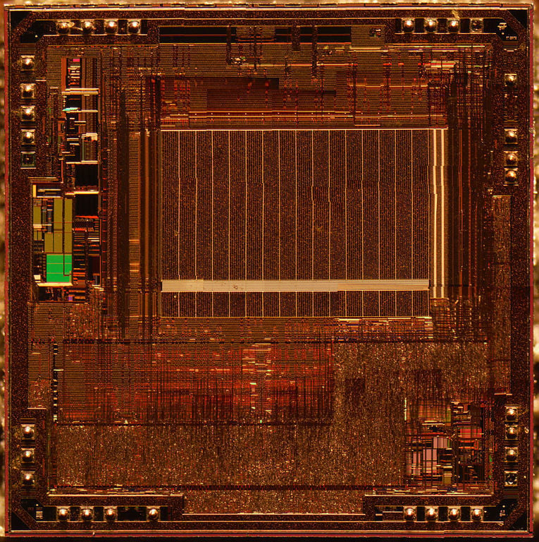
Memory management
Flash Memory Management
Flash memory is read-only during normal operation and is used to store the program code.
Use compiler optimization settings (e.g., -Os in GCC) to reduce code size.
Store constant data (e.g., lookup tables, strings) in flash using the PROGMEM directive.
Avoid frequent flash rewrites as they have limited write cycles.
Use bootloaders to simplify firmware updates without external programming tools.
Utilize segment analysis tools to track flash usage.

Slide 29
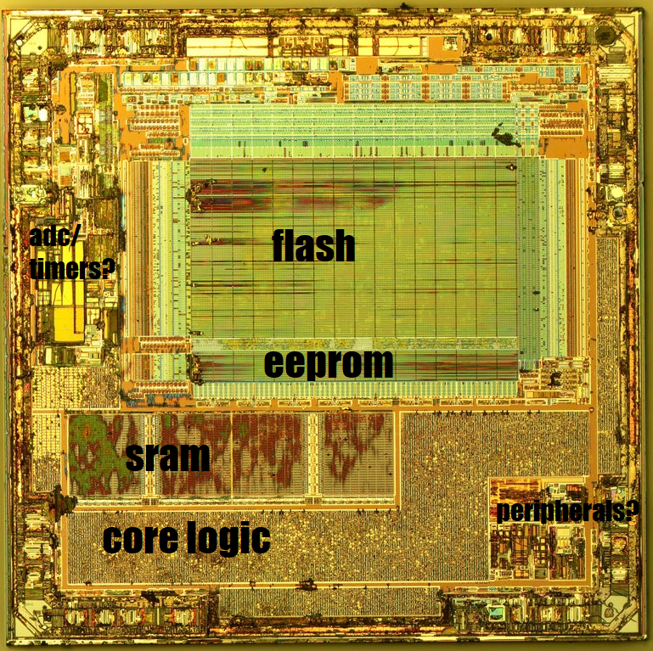
Memory management
SRAM Management
SRAM is used for runtime data, including global and local variables, stacks, and buffers.
Minimize global variables to reduce memory overhead.
Use stack-efficient coding practices, such as reusing local variables.
Avoid dynamic memory allocation (malloc/free) unless necessary, as it can lead to fragmentation.
Leverage data packing techniques, like using smaller data types or bit-fields.
Use static code analysis tools to detect potential SRAM overflows.

Slide 30
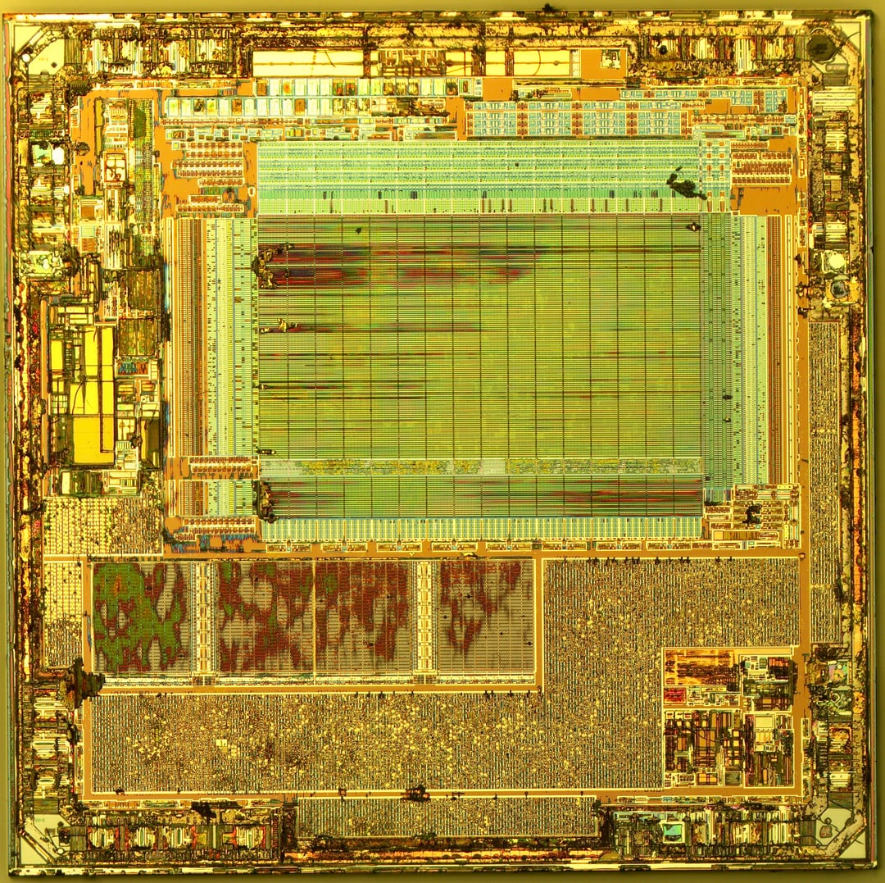
Memory management
EEPROM Management
EEPROM provides non-volatile storage for configuration or data that must persist after a reset or power loss.
Use the EEPROM library functions (eeprom_read_byte, eeprom_write_byte) for safe access.
Implement wear leveling to extend EEPROM lifespan.
Store frequently updated data in RAM and write it to EEPROM periodically.
Perform read-after-write operations to ensure data integrity.
Avoid writing to EEPROM in performance-critical sections due to slow write speeds.

